Slide 1
Fabrication of p-n junctions

Slide 2
What is fabrication?
Manufacturing process in which an item is made (fabricated) from raw or semi-finished materials instead of being assembled from ready-made components or parts.

Slide 3
Methods for fabrication of p-n junctions:
Thermal Oxidation
Diffusion
Rapid Thermal Processing
Ion Implantation
Chemical Vapor Deposition (CVD)
Photolithography
Etching
Metallization

Slide 4
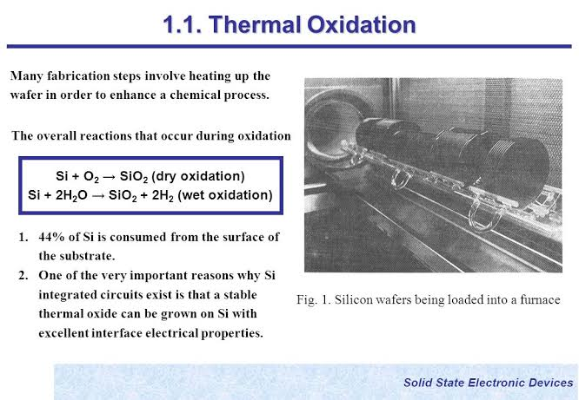
Thermal Oxidation
Thermal oxidation is a way to produce a thin layer of oxide (usually silicon dioxide) on the surface of a wafer.
The technique forces an oxidizing agent to diffuse into the wafer at high temperature and react with it.
Thermal oxidation of silicon is usually performed at a temperature between 800 and 1200 °C, resulting in so called High Temperature Oxide layer (HTO).
The reaction is one of the following:

Slide 5
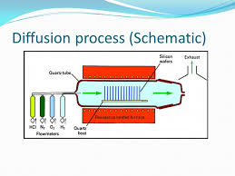
Diffusion
Thermal process that was used extensively in IC fabrication in the past is thermal in-diffusion
The wafers are first oxidized and windows are opened in the oxide using the photolithography and etching steps.
Dopants such as B, P, or As are introduced into these patterned wafers in a high temperature (∼800-1100°C) diffusion furnace, generally using a gas or vapor source.
The dopants are gradually transported from the high concentration region near the surface into the substrate through diffusion.

Slide 6
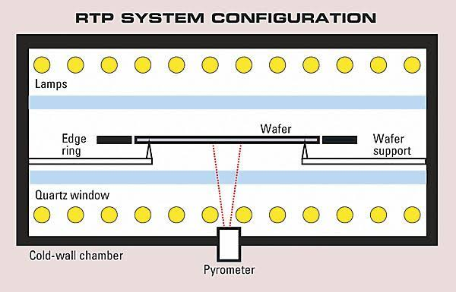
Rapid Thermal Processing(RTP)
Thermal steps formerly performed in furnaces are being done using rapid thermal processing (RTP).
This includes rapid thermal oxidation, annealing of ion implantation, and chemical vapor deposition.
Instead of having a large batch of wafers in a conventional furnace where the temperature cannot be changed rapidly, a single wafer is held, on low-thermal-mass quartz pins, surrounded by a bank of high-intensity (tens of kW) tungsten– halogen infrared lamps, with gold-plated reflectors around them.

Slide 7
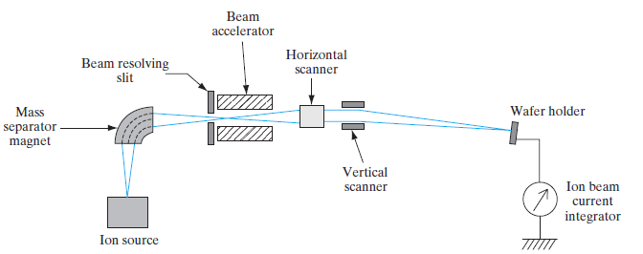
Ion Implantation
In this process a beam of impurity ions is accelerated to kinetic energies ranging from several keV to several MeV and is directed onto the surface of the semiconductor.
As the impurity atoms enter the crystal, they give up their energy to the lattice in collisions and finally come to rest at some average penetration depth, called the projected range.
An obvious advantage of implantation is that it can be done at relatively low temperatures; this means that doping layers can be implanted without disturbing previously diffused regions.
One of the major advantages of implantation is the precise control of doping concentration it provides.
One problem with this doping method is the lattice damage which results from collisions between the ions and the lattice atoms.

Slide 8
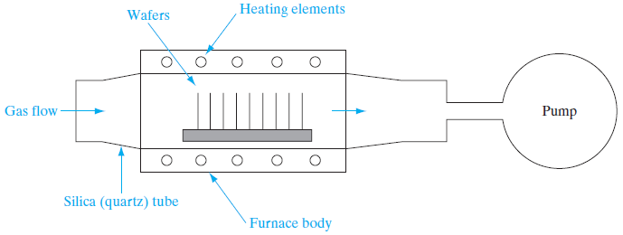
Chemical Vapor Deposition (CVD)
The CVD process reacts a Si-containing gas such as SiH4 with an oxygen-containing precursor, causing a chemical reaction, leading to the deposition of SiO2 on the substrate.
Being able to deposit SiO2 is very important in certain applications. As a complicated device structure is built up, the Si substrate may not be available for reaction, or there may be metallization on the wafer that cannot withstand very high temperatures. In such cases, CVD is a necessary alternative.
LPCVD is also widely used to deposit other dielectrics such as silicon nitride (Si3N4), and polycrystalline or amorphous Si.

Slide 9
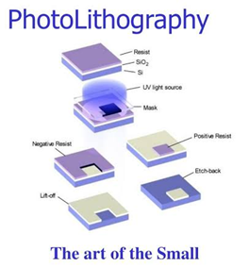
Photolithography
Patterns corresponding to complex circuitry are formed on a wafer using photolithography.
Opaque regions on the mask are made up of an ultraviolet (UV) light-absorbing layer, such as iron oxide.
It is usually created by a computer-controlled electron beam driven by the circuit layout data, using pattern generation software.
A resist is a thin organic polymer layer that undergoes chemical changes if it is exposed to energetic particles such as electrons or photons.
The resist is exposed selectively, corresponding to the patterns that are required. After exposure, the resist is developed in a chemical solution.
The exposure of the wafers is achieved die-by-die in a step-and-repeat system called a stepper

Slide 10
Etching
During IC fabrication, the whole wafer is completely covered with a layer or multi-llayers of silicon dioxide, silicon nitride, or metal. Etching is the process of removing unwanted parts of these layers in order to form holes for diffusion, electrical interconnections, to name a few.
Etching is a chemical process.
Different kinds of etching techniques included wet chemical, electrochemical, pure plasma, reactive ion etching (RIE), and high-temperature vapor etching.
Wet chemical etching is the oldest form available to IC manufacturing and the least expensive.
It involves a beaker of etching solution and few beakers of rinsing water.
The wafer is literally soaked in etching solutions then rinsed clean with water. The etching bath is temperature controlled and the solution is continuously being filtered and circulated.
Hot deionized water is used in the rinsing cycle.

Slide 11
Metallization
Metallizing is the general name for the technique of coating metal on the surface of objects. Metallic coatings may be decorative, protective or functional.
Vacuum metallizing involves heating the coating metal to its boiling point in a vacuum chamber, then letting condensation deposit the metal on the substrate's surface. Resistance heating, electron beam, or plasma heating is used to vaporize the coating metal.
Thermal spraying techniques are coating processes in which melted (or heated) materials are sprayed onto a surface.
Cold sprayable metal technology is a metallizing process that seamlessly applies cold sprayable or puttyable metal to almost any surface. The composite metal consists of two (waterbased binder) or three different ingredients: metal powder, binder and hardener.
The mixture of the ingredients is cast or sprayed on the substrate at room temperature. The desired effect and the necessary final treatment define the thickness of the layer, which normally varies between 80 and 150 µm.

Slide 12
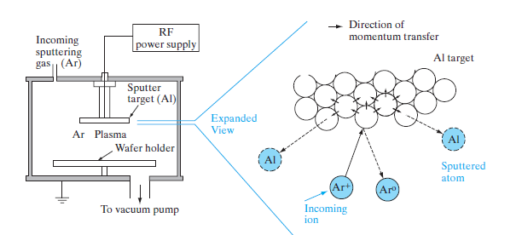


Slide 13
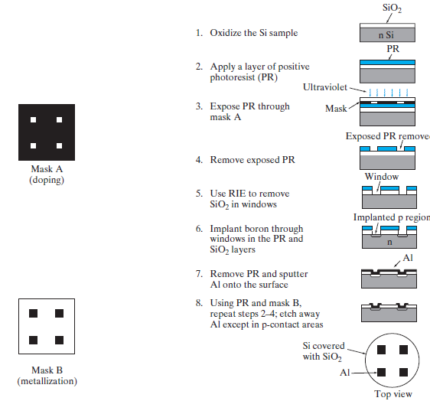
Fig: Simplified description of steps in the fabrication of p-n junctions.

